Slide 1
Chapter 4：STATIC GAMES OF COMPLETE INFORMATION: Rationality and Common Knowledge

Slide 2
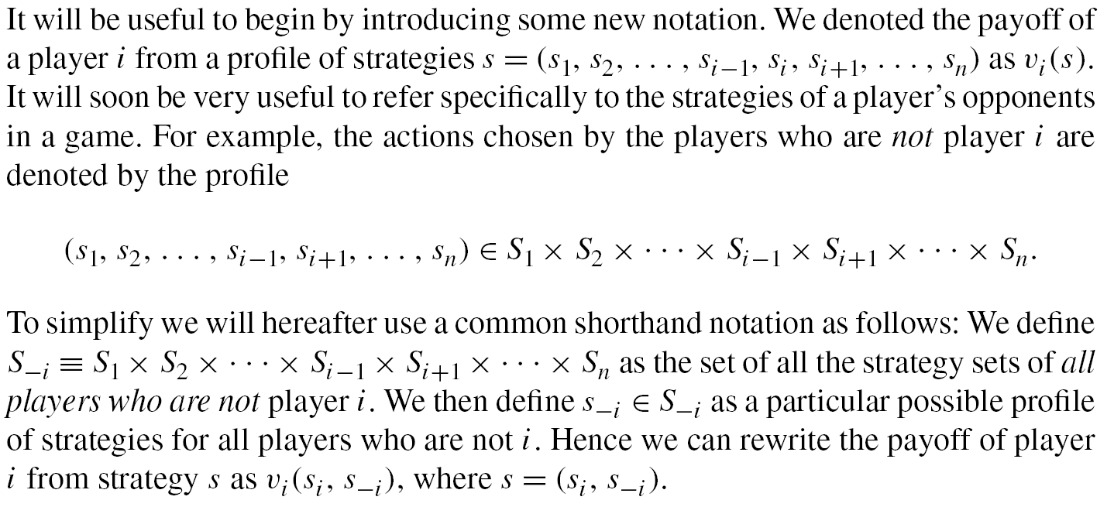
4.1 Dominance in Pure Strategies
博弈论与信息经济学
北京航空航天大学经济管理学院 崔志伟

Slide 3
4.1.1 Dominated Strategies
Consider the Prisoner’s Dilemma.
Player 2
M
F
M
-2, -2 | -5, -1
-1, -5 | -4, -4
Player 1
F
Playing M is worse than playing F for each player regardless of
what the player’s opponent does.
博弈论与信息经济学
北京航空航天大学经济管理学院 崔志伟

Slide 4
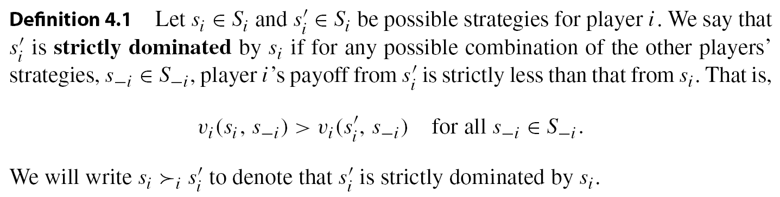
Claim 4.1 A rational player will never play a strictly dominated strategy.
If a player plays a dominated strategy then he cannot be playing optimally because the player has another strategy that will yield him a higher payoff regardless of the strategies of his opponents.
博弈论与信息经济学
北京航空航天大学经济管理学院 崔志伟

Slide 5
When we apply the notion of a dominated strategy to the Prisoner’s Dilemma we argue that each of the two players has one dominated strategy that he should never use, and hence each player is left with one strategy that is not dominated. Therefore, for the Prisoner’s Dilemma, rationality alone is enough to offer a prediction about which outcome will prevail: (F, F) is this outcome.
Does this conclusion holds for any game?
博弈论与信息经济学
北京航空航天大学经济管理学院 崔志伟

Slide 6
Consider the following advertising game. Two competing brands can choose one of three marketing campaigns—low (L), medium (M), and high (H)—with payoffs given by the following matrix:
Player 2
L
M
H
L
6, 6 | 2, 8 | 0, 4
8, 2 | 4, 4 | 1, 3
4, 0 | 3, 1 | 2, 2
Player 1
M
H
Each player has one dominated strategy, which is L. However, neither M nor H is dominated. For example, if player 2 plays M then player 1 should also play M, while if player 2 plays H then player 1 should also play H. Hence rationality alone does not offer a unique prediction.
博弈论与信息经济学
北京航空航天大学经济管理学院 崔志伟

Slide 7
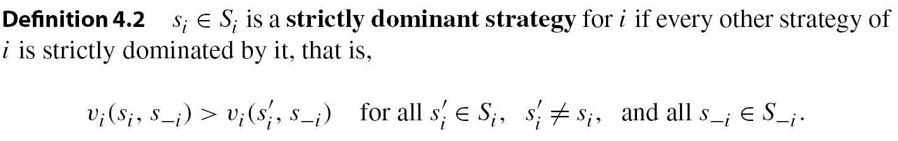
4.1.2 Dominant Strategy Equilibrium
A strictly dominated strategy is one to avoid at all costs. There is a counterpart strategy, represented by F in the Prisoner’s Dilemma, that would be desirable. This is a strategy that is always the best thing you can do, regardless of what your opponents choose.
博弈论与信息经济学
北京航空航天大学经济管理学院 崔志伟

Slide 8

If every player had such a wonderful dominant strategy, then it would be a very sensible predictor of behavior because it follows from rationality alone. We can introduce this simple idea as our first solution concept:
This gives a formal definition for the outcome “both players fink,” or (F, F), in the Prisoner’s Dilemma: it is a dominant strategy equilibrium. In this equilibrium the payoffs are (−4, −4) for players 1 and 2, respectively.
博弈论与信息经济学
北京航空航天大学经济管理学院 崔志伟

Slide 9
4.1.3 Evaluating Dominant Strategy Equilibrium
Proposition 4.1 is very useful in addressing one of our proposed criteria for evaluating a solution concept: when it exists, the strict-dominance solution concept guarantees uniqueness. However, what do we know about existence?
Chris
Consider the Battle of the Sexes game.
O
F
O
2, 1 | 0, 0
0, 0 | 1, 2
Alex
F
Neither player has a dominant strategy either. The best strategy for Chris depends on what Alex chooses and vice versa. Thus if we stick to the solution concept of strict dominance we will encounter games, in fact many of them, for which there will be no equilibrium.
博弈论与信息经济学
北京航空航天大学经济管理学院 崔志伟

Slide 10

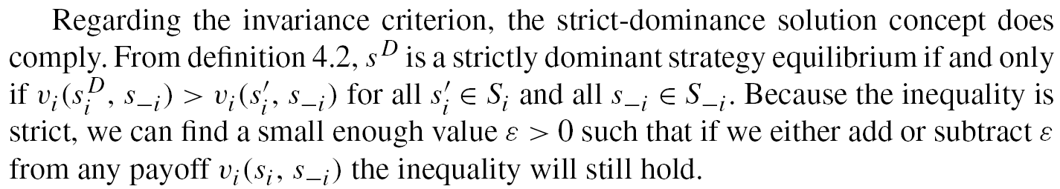
We now turn to the Pareto criterion of equilibrium outcomes when a strict dominance solution exists. The Prisoner’s Dilemma has an equilibrium prediction using the strict-dominance solution concept, so we can evaluate the efficiency properties of the unique strictly dominant strategy equilibrium for that game. The outcome prescribed by this solution is not Pareto optimal: both players would be better off if each plays M.
博弈论与信息经济学
北京航空航天大学经济管理学院 崔志伟

Slide 11

The failure of Pareto optimality implies that the players would benefit from modifying the environment in which they find themselves to create other enforcement mechanisms—for example, creating a “mafia” with norms of conduct that enforce implicit agreements so as to punish those who fink.
博弈论与信息经济学
北京航空航天大学经济管理学院 崔志伟

Slide 12
To explicitly see how this can work, imagine that a mafia member who finks on another member is very seriously reprimanded, which will change the payoff structure of the Prisoner’s Dilemma if he is caught. If the pain from mafia punishment is equivalent to z, then we have to subtract z units of payoff for each player who finks. The “mafia-modified” Prisoner’s Dilemma is represented by the following matrix:
Player 2
M
F
M
-2, -2 | -5, -1-z
-1-z, -5 | -4-z, -4-z
Player 1
F
博弈论与信息经济学
北京航空航天大学经济管理学院 崔志伟

Slide 13
Player 2
M
F
M
-2, -2 | -5, -1-z
-1-z, -5 | -4-z, -4-z
Player 1
F
If z is strictly greater than 1 then this punishment will be enough to flip our predicted equilibrium outcome of the game because then M becomes the strict dominant strategy (and (M,M) is Pareto optimal).
This example demonstrates that “institutional design,” which changes the game that players play, can be very useful in affecting the well-being of players. By introducing this external enforcer, or institution, we are able to get the players to choose outcomes that make them both better off compared to what they can achieve without the additional institution.
博弈论与信息经济学
北京航空航天大学经济管理学院 崔志伟

Slide 14
军备竞赛
两国之间的军备竞赛可以用囚徒困境来描述。两国都可以声称有两种选择：增加军备（背叛）、或是达成削减武器协议（合作）。两国都无法肯定对方会遵守协议，因此两国最终会倾向增加军备。似乎自相矛盾的是，虽然增加军备会是两国的“理性”行为，但结果却显得“非理性”（例如会对经济造成损坏等）。这可视作遏制理论的推论，就是以强大的军事力量来遏制对方的进攻，以达到和平。
关税战
两个国家，在关税上可以有以下两个选择: 提高关税，以保护自己的商品。（背叛）
与对方达成关税协定，降低关税以利各自商品流通。（合作）
当一国因某些因素不遵守关税协定，而独自提高关税（背叛）时，另一国也会作出同样反应（亦背叛），这就引发了关税战，两国的商品失去了对方的市场，对本身经济也造成损害（共同背叛的结果）。然后二国又重新达成关税协定。（重复博弈的结果是将发现共同合作利益最大。）
博弈论与信息经济学
北京航空航天大学经济管理学院 崔志伟

Slide 15
广告战
商业活动中亦会出现各种囚徒困境例子。以广告竞争为例。
两个公司互相竞争，两个公司的广告互相影响，即一公司的广告较被顾客接受则会夺取对方的部分收入。但若二者同时期发出品质类似的广告，收入增加很少但成本增加。但若不提高广告品质，生意又会被对方夺走。
此二公司可以有二选择：互相达成协议，减少广告的开支。（合作）增加广告开支，设法提升广告的品质，压倒对方。（背叛）
若二公司不信任对方，无法合作，背叛成为支配性策略时，二公司将陷入广告战，而广告成本的增加损害了二公司的收益，这就是陷入囚徒困境。在现实中，要二互相竞争的公司达成合作协议是较为困难的，多数都会陷入囚徒困境中。
博弈论与信息经济学
北京航空航天大学经济管理学院 崔志伟

Slide 16

一些媒体曾经计算过快递费用的分配。如果用户支付10元快递费，其中包括3元归网点费、1.6元归快递员、0.6元是城市分拨费、分拨中心费0.3元、1元总部面单费、2元中转费和1.5元派件费。
博弈论与信息经济学
北京航空航天大学经济管理学院 崔志伟

Slide 17

博弈论与信息经济学
北京航空航天大学经济管理学院 崔志伟

Slide 18
自行车赛例子
自行车赛事的比赛策略也是一种博弈，而其结果可用囚徒困境的研究成果解释。
例如：每年都举办的环法自行车赛中有以下情况：选手们在到终点前的路程常以“大队伍”（法语：peloton） 方式前进，他们采取这策略是为了令自己不至于太落后，又出力适中。而最前方的选手在迎风时是最费力的，所以选择在前方是最差的策略。通常会发生这样的情况，大家起先都不愿意向前（共同背叛），这使得全体速度很慢，而后通常会有二或多位选手骑到前面，然后一段时间内互相交换最前方位置，以分担风的阻力（共同合作），使得全体的速度有所提升，而这时如果前方的其中一人试图一直保持前方位置（背叛），其他选手以及大队伍就会赶上（共同背叛）。而通常的情况是，在最前面次数最多的选手（合作）通常会到最后被落后的选手赶上（背叛），因为后面的选手骑在前面选手的冲流之中，比较不费力。
博弈论与信息经济学
北京航空航天大学经济管理学院 崔志伟

Slide 19
4.2 Iterated Elimination of Strictly Dominated Pure Strategies
The requirement that players are rational implies two important conclusions:
1. A rational player will never play a dominated strategy.
2. If a rational player has a strictly dominant strategy then he will play it.
We used the second conclusion to define the solution concept of strict dominance. A drawback of the dominant strategy solution concept is, however, that it will often fail to exist.
Hence if we wish to develop a predictive theory of behavior in games we must consider alternative approaches that will apply to a wide variety of games.
博弈论与信息经济学
北京航空航天大学经济管理学院 崔志伟

Slide 20
4.2.1 Iterated Elimination and Common Knowledge of Rationality
We begin with the premise that players are rational, and we build on the first conclusion in the previous section, which claims that a rational player will never play a dominated strategy. This conclusion is useful in that it rules out what players will not do.
博弈论与信息经济学
北京航空航天大学经济管理学院 崔志伟

Slide 21
The introduction of common knowledge of rationality allows us to do much more than identify strategies that rational players will avoid.
If indeed all the players know that each player will never play a strictly dominated strategy, they can effectively ignore those strictly dominated strategies that their opponents will never play, and their opponents can do the same thing.
If the original game has some players with some strictly dominated strategies, then all the players know that effectively they are facing a “smaller” restricted game with fewer total strategies.
博弈论与信息经济学
北京航空航天大学经济管理学院 崔志伟

Slide 22
Because it is common knowledge that all players are rational, then everyone knows that everyone knows that the game is effectively a smaller game.
In this smaller restricted game, everyone knows that players will not play strictly dominated strategies. We may find additional strategies that are dominated in the restricted game that were not dominated in the original game.
Because it is common knowledge that players will perform this kind of reasoning again, the process can continue until no more strategies can be eliminated in this way.
博弈论与信息经济学
北京航空航天大学经济管理学院 崔志伟

Slide 23
Player 2
L
C
R
U
4, 3 | 5, 1 | 6, 2
2, 1 | 8, 4 | 3, 6
3, 0 | 9, 6 | 2, 8
Player 1
M
D
There is no strictly dominant strategy, neither for player 1 nor for player 2. There is no strictly dominated strategy for player 1. There is, however, a strictly dominated strategy for player 2: the strategy C is strictly dominated by R because 2 > 1 (row U), 6 > 4 (row M), and 8> 6 (row D). Thus, because this is common knowledge, both players know that we can effectively eliminate the strategy C from player 2’s strategy set:
博弈论与信息经济学
北京航空航天大学经济管理学院 崔志伟

Slide 24
Player 2
L
R
U
4, 3 | 6, 2
2, 1 | 3, 6
3, 0 | 2, 8
Player 1
M
D
In this reduced game, both M and D are strictly dominated by U for player 1. Eliminating these two strategies yields the following trivial game:
Player 2
L
R
Player 1
U
4, 3 | 6, 2
博弈论与信息经济学
北京航空航天大学经济管理学院 崔志伟

Slide 25
This process of iterated elimination of strictly dominated strategies (IESDS) builds on the assumption of common knowledge of rationality.
The first step of iterated elimination is a consequence of player 2’s rationality; the second stage follows because players know that players are rational; the third stage follows because players know that players know that they are rational, and this ends in a unique prediction.
博弈论与信息经济学
北京航空航天大学经济管理学院 崔志伟

Slide 26
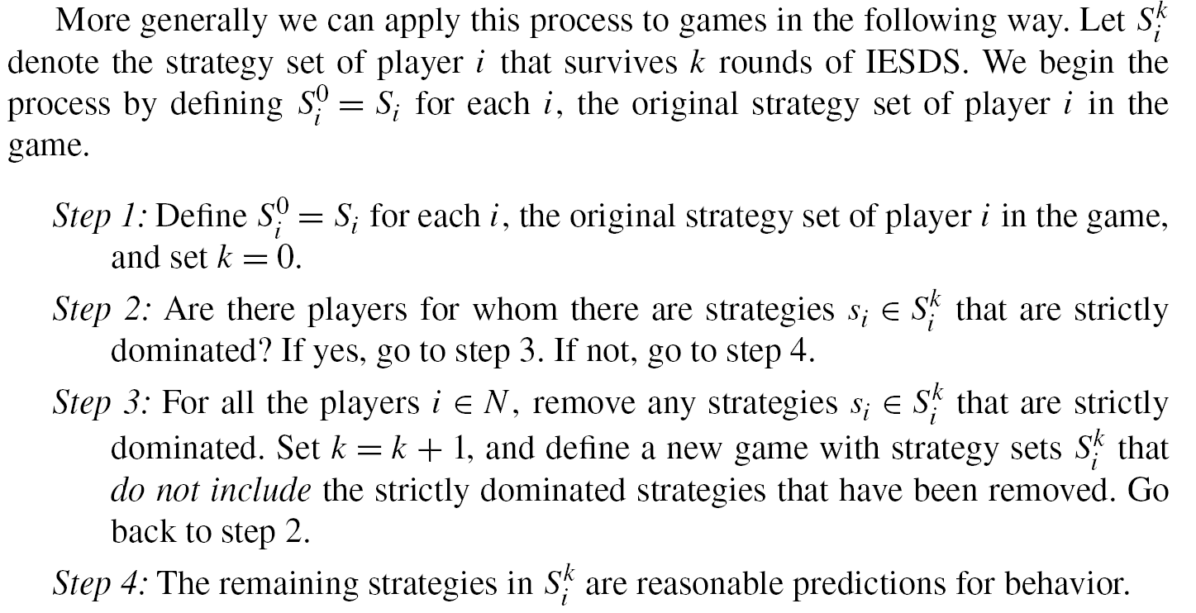
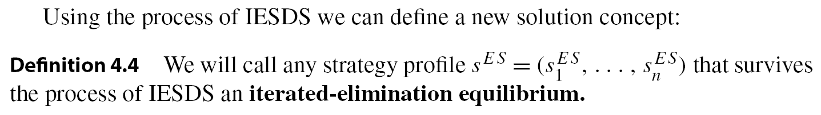
博弈论与信息经济学
北京航空航天大学经济管理学院 崔志伟

Slide 27
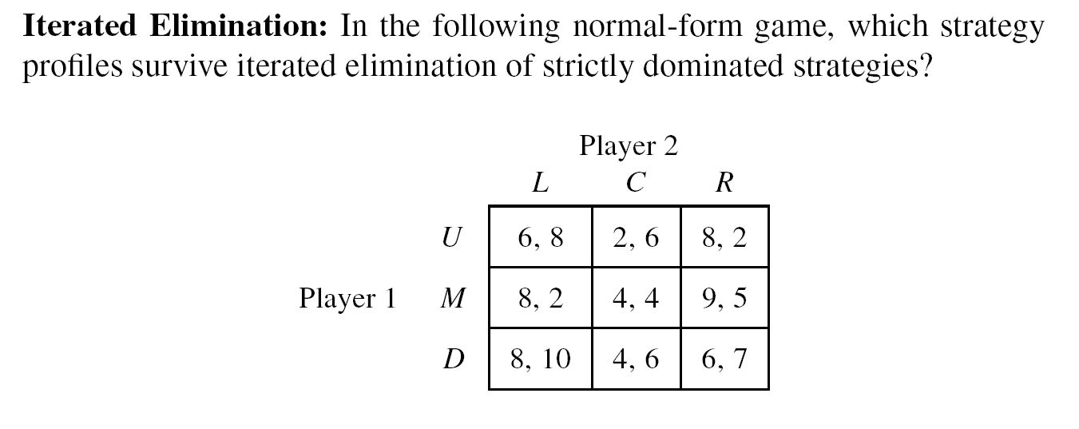
博弈论与信息经济学
北京航空航天大学经济管理学院 崔志伟

Slide 28
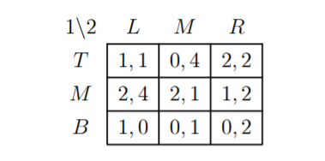
博弈论与信息经济学
北京航空航天大学经济管理学院 崔志伟

Slide 29
4.2.3 Evaluating IESDS
Start with existence and note that, unlike the concept of strict dominance, we can apply IESDS to any game by applying the algorithm just described.
IESDS does not require the existence of a strictly dominant strategy, nor does it require the existence of strictly dominated strategies.
博弈论与信息经济学
北京航空航天大学经济管理学院 崔志伟

Slide 30
Consider the Battle of the Sexes game.
Chris
O
F
O
2, 1 | 0, 0
0, 0 | 1, 2
Alex
F
IESDS cannot restrict the set of strategies here for the simple reason that neither O nor F is a strictly dominated strategy for each player.
This solution concept can be applied (it exists) to any game, but it will often fail to provide a unique solution. For the Battle of the Sexes game, IESDS can only conclude that “anything can happen.”
博弈论与信息经济学
北京航空航天大学经济管理学院 崔志伟

Slide 31
An easy illustration can be provided by the Prisoner’s Dilemma. IESDS leaves (F, F) as IESDS equilibrium, after one round of elimination. As we already demonstrated, (F, F) is not Pareto optimal.
There is a simple and quite obvious relationship between the IESDS solution concept and the strict-dominance solution concept:
博弈论与信息经济学
北京航空航天大学经济管理学院 崔志伟

Slide 32
4.3 Beliefs, Best Response, and Rationalizability
When we considered eliminating strategies that no rational player would choose to play, it was by finding some strategy that is always better or dominates the eliminated strategies.
A strategy that cannot be eliminated, therefore, suggests that under some conditions this strategy is the one that the player may like to choose.
博弈论与信息经济学
北京航空航天大学经济管理学院 崔志伟

Slide 33
Think about situations in which you were puzzled about the behavior of someone you knew. To consider his choice as irrational, or simply stupid, you would have to consider whether there is a way in which he could defend his action as a good choice.
A natural way to determine whether this is the case is to simply ask him, “What were you thinking?” If the response lays out a plausible situation for which his choice was a good one, then you cannot question his rationality.
If a strategy s_{i} is not strictly dominated for player i then it must be that there are combinations of strategies of player i’s opponents for which the strategy s_{i} is player i’s best choice. This reasoning will justify or rationalize the choice of player i.
博弈论与信息经济学
北京航空航天大学经济管理学院 崔志伟

Slide 34
Chris
O
F
O
2, 1 | 0, 0
0, 0 | 1, 2
Alex
F
The best choice of Alex depends on what Chris will do. If Chris goes to the opera then Alex would rather go to the opera instead of going to the football game. If, however, Chris goes to the football game then Alex’s optimal action is switched around.
博弈论与信息经济学
北京航空航天大学经济管理学院 崔志伟

Slide 35
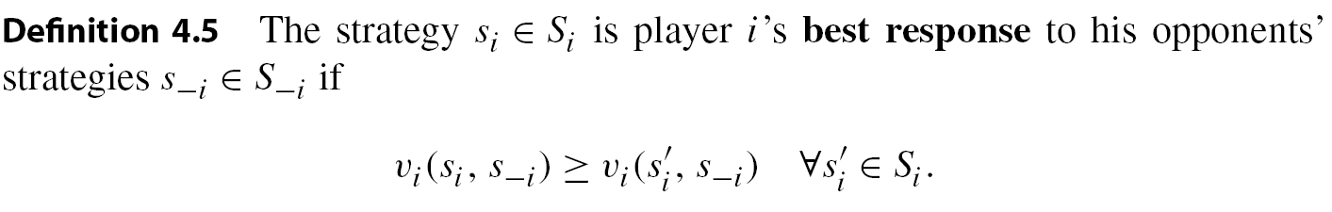
In order for a player to be optimizing in a game, he has to choose a best strategy as a response to the strategies of his opponents.
Rationality implies that given any belief a player has about his opponents’ behavior, he must choose an action that is best for him given his belief.
博弈论与信息经济学
北京航空航天大学经济管理学院 崔志伟

Slide 36
In the Battle of the Sexes, if Chris believes that Alex will go to the opera then Chris’s best response is to go to the opera because
v₂(O, O)=1>v₂(F, O)=0.
If Chris believes that Alex will go to the football game then Chris’s best response is to go to the game as well.
There are some appealing relationships between the concept of playing a best response and the concept of dominated strategies. First, if a strategy s_{i} is strictly dominated, it means that some other strategy s’_{i} is always better.
博弈论与信息经济学
北京航空航天大学经济管理学院 崔志伟

Slide 37
A companion to this proposition would explore strictly dominant strategies, which are in some loose way the “opposite” of strictly dominated strategies.
博弈论与信息经济学
北京航空航天大学经济管理学院 崔志伟

Slide 38
If my best response depends on what the other players are doing, then how should I choose between all the best responses I can possibly have?
To tackle this question, we need to give players the ability to form conjectures about what others are doing.
Thus we have to be mindful of what a player believes in order to draw conclusions about whether or not the player is choosing a best response.
博弈论与信息经济学
北京航空航天大学经济管理学院 崔志伟

Slide 39
4.3.2 Beliefs and Best-Response Correspondences
Suppose that s_{i} is a best response for player i to his opponents playing s_{-i}, and assume that it is not a best response for any other profile of actions that i’s opponents can choose. When would a rational player i choose to play s_{i}?
The answer follows directly from rationality: he will play s_{i} only when his beliefs about other players’ behavior justify the use of s_{i}, or when he believes that his opponents will play s_{-i}.
博弈论与信息经济学
北京航空航天大学经济管理学院 崔志伟

Slide 40
Introducing the concept of beliefs, and actions that best respond to beliefs, is central to the analysis of strategic behavior.
If a player is fortunate enough to be playing in a game in which he has a strictly dominant strategy then his beliefs about the behavior of others play no role. The player’s strictly dominant strategy is his best response independent of his opponents’ play, and hence it is always a best response.
When no strictly dominant strategy exists, a player must ask himself, “What do I think my opponents will do?” The answer to this question should guide his own behavior.
博弈论与信息经济学
北京航空航天大学经济管理学院 崔志伟

Slide 41
Given that a player has a particular belief about his opponents’ strategies, he will be able to formulate a best response to that belief. The best response of a player to a certain strategy of his opponents may be unique.
Consider the Battle of the Sexes. When Chris believes that Alex is going to the opera, his unique best response is to go to the opera. If he believes that Alex will go to the football game, then he should go to the football game.
博弈论与信息经济学
北京航空航天大学经济管理学院 崔志伟

Slide 42
We can think of a rational player as having a recipe book that is a list of instructions as follows: “If I think my opponents are doing s_{−i}, then I should do s_{i}; if I think they’re doing s’_{−i}, then I should do s’_{i};. . . . ”
This list should go on until it exhausts all the possible strategies that player i’s opponents can choose. If we think of this list of best responses as a plan, then this plan maps beliefs into a choice of action, and this choice of action must be a best response to the beliefs.
We can think of this as player i’s best-response function.
博弈论与信息经济学
北京航空航天大学经济管理学院 崔志伟

Slide 43
There may be games in which for some beliefs a player will have more than one best-response strategy. Consider, for example, the following simple game
Player 2
L
C
R
U
3, 3 | 5, 1 | 6, 2
4, 1 | 8, 4 | 3, 6
4, 0 | 9, 6 | 6, 8
Player 1
M
D
If player 1 believes that player 2 is playing the column R then both U and D are each a best response. If player 1 believes that player 2 is playing the column L then both M and D are each a best response.
博弈论与信息经济学
北京航空航天大学经济管理学院 崔志伟

Slide 44
The fact that a player may have more than one best response implies that we can’t think of the best-response mapping from opponents’ strategies S_{−i} to an action by player i as a function, because a function would select only one action as a best response.
Given a belief player i has about his opponents, s_{−i}, the set of all his possible strategies that are a best response to s_{−i} is denoted by BR_{i}(s_{−i}).
博弈论与信息经济学
北京航空航天大学经济管理学院 崔志伟

Slide 45
4.3.3 Rationalizability
To a large extent we employed similar reasoning when we introduced the solution concept of IESDS: instead of asking what your opponents might be doing, you asked “What would a rational player not do?” Then, assuming that all players follow this process by common knowledge of rationality, we were able to make some prediction about which strategies cannot be eliminated.
A rational player will select only strategies that are a best response to some profile of his opponents. Thus we have
博弈论与信息经济学
北京航空航天大学经济管理学院 崔志伟

Slide 46
The next step, as in IESDS, is to use the common knowledge of rationality to build an iterative process that takes this reasoning to the limit.
After employing this reasoning one time, we can eliminate all the strategies that are never a best response, resulting in a possibly “smaller” reduced game that includes only strategies that can be a best response in the original game. Then we can employ this reasoning again and again, in a similar way that we did for IESDS, in order to eliminate outcomes that should not be played by players who share a common knowledge of rationality.
The solution concept of rationalizability is defined precisely by iterating this thought process. The set of strategy profiles that survive this process is called the set of rationalizable strategies.
博弈论与信息经济学
北京航空航天大学经济管理学院 崔志伟

Slide 47
Player 2
L
C
R
U
3, 3 | 5, 1 | 6, 2
4, 1 | 8, 4 | 3, 6
2, 0 | 9, 6 | 7, 8
Player 1
M
D
In this game, U is never a best response. However, U is not a dominated strategy.
Rationalizable strategies？
IESDS？
博弈论与信息经济学
北京航空航天大学经济管理学院 崔志伟

Slide 48
4.3.5 The “p-Beauty Contest”
Consider a game with n players, so that N = {1, . . . , n}. Each player has to choose an integer between 0 and 20, so that S_{i} = {0, 1, 2, . . . , 19, 20}. The winners are the players who choose an integer number that is closest to 3/4 of the average. For example, if n = 3, and if the three players choose s₁= 1, s₂ = 5, and s₃ = 18, then the average is (1+5+18) ÷3= 8, and 3/4 of the average is 6, so the winner is player 2. This game is called the p-beauty contest.
博弈论与信息经济学
北京航空航天大学经济管理学院 崔志伟

Slide 49
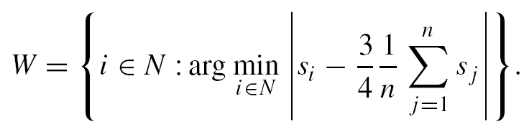
It is possible for more than one person to be a winner. If, for example, s₁= s₂ = 2 and s₃ = 8, then the average is 4 and 3/4 of the average is 3, so that both player 1 and player 2 are winners.
Let the set of winners W ⊂ N be those players who are closest to 3/4 of the average, and the rest are all losers. The set of winners is defined as
To introduce payoffs, each player pays 1 to play the game, and winners split the pot equally among themselves. This implies that if there are m ≥ 1 winners, each gets a payoff of (N−m)/m (his share of the pot net of his own contribution) while losers get −1 (they lose their contribution).
博弈论与信息经济学
北京航空航天大学经济管理学院 崔志伟

Slide 50
Turning to rationalizable strategies, we begin by finding strategies that are never a best response. In particular the objective is to guess a number closest to 3/4 of the average.
If there are strategies that are never a best response, they should be the higher numbers, and it is natural to start with 20.
If you believe that the average is below 20, then 20 cannot be a best response—a lower number will be the best response.
If the average were 20, everyone would be choosing 20, and you would then split the pot with all the other players. If you believe this, and instead of 20 you choose 19, then you will win the whole pot for sure. This shows that 20 can never be a best response.
博弈论与信息经济学
北京航空航天大学经济管理学院 崔志伟

Slide 51
Only the numbers in S¹_{i} = {0, 1, . . . , 19} survive the first round of rationalizable behavior. Similarly after each additional round we will “lose” the highest number until we go through 19 rounds and are left with S¹⁹_{i} = {0, 1}, meaning that after 19 rounds of dropping strategies that cannot be a best response, we are left with two strategies: 1 and 0.
If n > 2, we cannot reduce this set further. If player i believes that all the other players are choosing 1 then choosing 1 is a best response for him. If he believes that everyone is choosing 0 then choosing 0 is his best response.
Thus we are able to predict using rationalizability that players will not choose a number greater than 1, and if there are only two players then we will predict that both will choose 0. Why?
博弈论与信息经济学
北京航空航天大学经济管理学院 崔志伟

Slide 52

博弈论与信息经济学
北京航空航天大学经济管理学院 崔志伟

Slide 53
Will this indeed predict behavior?
If you were to play this game and you don’t think that your opponents are doing these steps in their minds, then you may want to choose a number higher than 1.
An interesting set of experiments is summarized in Camerer (2003).
博弈论与信息经济学
北京航空航天大学经济管理学院 崔志伟

Slide 54
4.3.6 Evaluating Rationalizability
In terms of existence, uniqueness, and implications for Pareto optimality, rationalizability is practically the same as IESDS. It will sometimes have bite, and may even restrict behavior quite dramatically as in the examples given. But if applied to the Battle of the Sexes, rationalizability will say “anything can happen.”
博弈论与信息经济学
北京航空航天大学经济管理学院 崔志伟

Slide 55
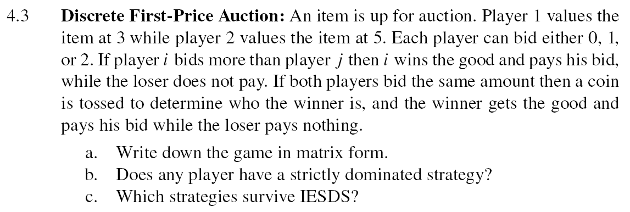
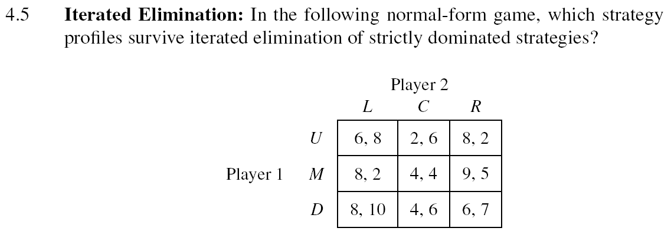
博弈论与信息经济学
北京航空航天大学经济管理学院 崔志伟

Slide 56
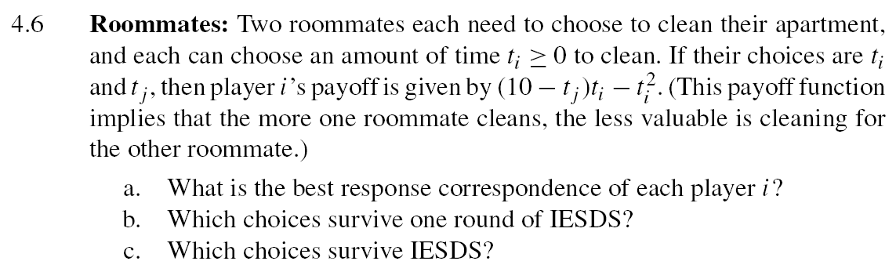
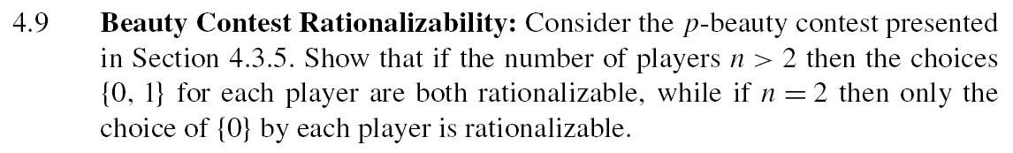
博弈论与信息经济学
北京航空航天大学经济管理学院 崔志伟

